Slide 1


Gate level Modelling
Group member
ADITYA RAHANGDALE (21BCY10003) SHREY BHATT (21BCE11641) ABANTEEKA ACHARYA (21BCY10005) SANJIPAN DEB (21BCY10015) SIDDHARTH DAYAL (21BCY10019)

Slide 2


CONTEXT
What is Gate level modelling ?
Types of Gate level modelling ?
Gate level modelling of 4*1 multiplexer
Gate level modelling of Half adder
Gate level modelling of full adder

Slide 3
WHAT IS GATE LEVEL MODELLING ?
Designing circuits using basic logic gates is known as gate-level modelling.
A digital circuit is implemented using logic gates and interconnections
between these gates. The primitives
(The most language)
basic commands of a defined in
Verilog
the
have user
been set keeping
requirements in mind making it easy to design bigger blocks.

Slide 4
TYPES OF GATE LEVEL MODELLING ?
Verilog supports built-in primitive gates modeling. The gates supported are:
1.Multiple-input
The multiple-input gates are AND, NAND, OR, NOR, XOR and
XNOR whose number of inputs are two or more, and has only one output.
2.Multiple-output The multiple-output gates are BUF and
NOT whose output is one or more and has only one input.
3.tri-state
tri-state gates, including
bufif0, bufif1, notif0, and
4.pull gates
The pull gates
are pullup and
notif1. These gates have _{pulldown with a}
one input, one control signal, and one output.
single output
only.

Slide 5
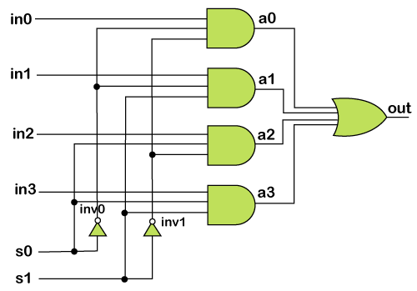
Gate Level Modeling of a Multiplexer
The gate-level circuit diagram of 4x1 mux is shown below. It is used to write a module for 4x1 mux.
module 4x1_mux (out, in0, in1, in2, in3, s0,
s1);
// port declarations output out; // Output port.
input in0, in1, in2. in3; // Input ports. input s0, s1; // Input ports: select lines.
// intermediate wires
wire inv0, inv1; // Inverter outputs. wire a0, a1, a2, a3; // AND gates outputs.

Slide 6
// Inverters.
not not_0 (inv0, s0); not not_1 (inv1, s1);
// 3-input AND gates. and and_0 (a0, in0, inv0, inv1);
and and_1 (a1, in1, inv0, s1); and and_2 (a2, in2, s0, inv1); and and_3 (a3, in3, s0, s1);
// 4-input OR gate.
or or_0 (out, a0, a1, a2, a3);
endmodule

Slide 7
GATE LEVEL MODELLING OF
HALF ADDER

Slide 8
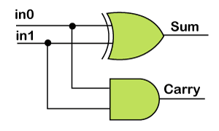
Gate Level Modeling of a Half Adder
1. module half_adder (sum, carry, in0, in1); 2.
3.
4.
5.
6.
7.
8.
9.
10.
11.
12.
output sum, carry; input in0, in1;
// 2-input XOR gate. xor xor_1 (sum, in0, in1);
// 2-input AND gate. and and_1 (carry, in0, in1);
endmodule

Slide 9
GATE LEVEL MODELLING OF
FULL ADDER

Slide 10
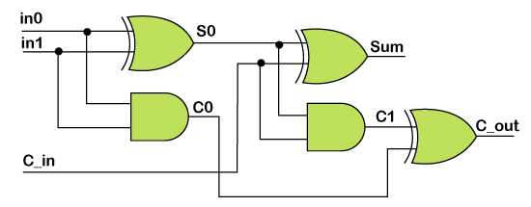
Gate Level Modeling of a Full Adder
The gate-level circuit diagram of Full Adder made out of 2 Half Adder and one xor gate is shown below

Slide 11
module full_adder (sum, c_out, ino, in1, c_in);
output sum, c_out; input in0, in1, c_in;
wire s0, c0, c1;
// Half adder: port connecting by order. half_adder ha_0 (s0, c0, in0, in1);

Slide 12


// Half adder : port connecting by name. half_adder ha_1 (.sum(sum),
.in0(s0),
.in1(c_in),
.carry(c1));
// 2-input XOR gate, to get c_out. xor xor_1 (c_out, c0, c1);
endmodule
1.

Slide 13
THANK YOU

